Slide 1

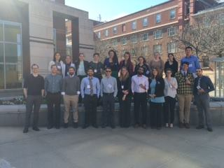
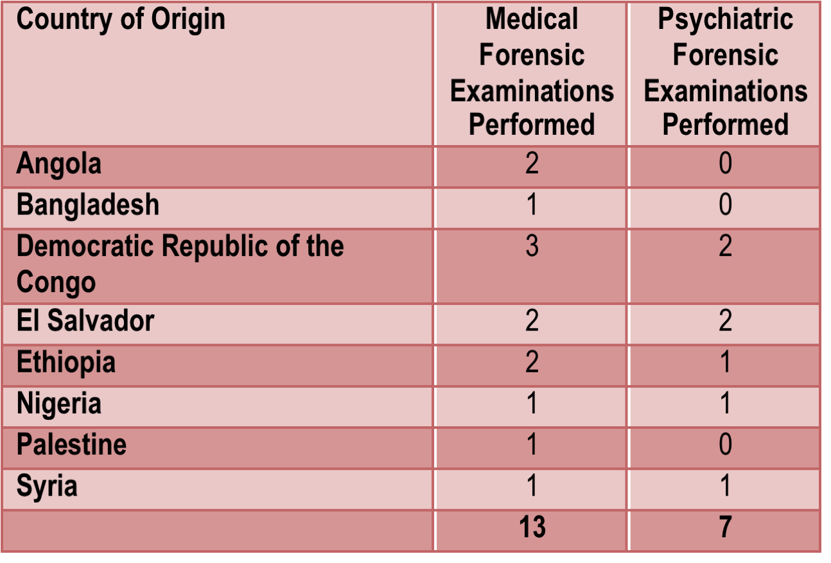

Creation and Implementation of a Student-Run Asylum Clinic
Sarah Riley; Lauren Jepson; Kim Griswold, M.D., M.P.H.
University at Buffalo, State University of New York, School of Medicine and Biomedical Sciences, Buffalo, NY.
Introduction
Background
Outcomes
Discussion
The Western New York Human Rights Clinic is a student-run clinic created in 2014 to facilitate forensic examinations for survivors of torture seeking asylum in the United States. Clients are referred from Physicians for Human Rights (PHR) as well as a local partnering agency, the WNY Center for Survivors of Refugee Trauma and Torture.** Medical student volunteers sit in on the forensic examinations and serve as scribes, then draft an affidavit which is used as evidence in the client’s legal asylum case. The affidavits document physical and psychological evidence of torture and assess consistency with the client’s story.
Our clients are asylum seekers, defined as any person outside of his or her country of nationality who, because of a “well-founded” fear of persecution on account of race, religion, nationality, membership in a particular social group, or political opinion” are unable to return to their home country, and are seeking protection in the United States.
When forensic exams are included as evidence in an asylum case, the client’s chance of being granted status is raised on average from 37.5% to 89%.¹ In Buffalo, these chances are even lower, with rates ranging from 10-21%.² Because of its proximity to Vive La Casa - a shelter for undocumented immigrants - and the near-by Batavia Detention Center, Buffalo has a considerable number of people seeking protective status in the US.
Inspired by the increasing need for these forensic exams and successful student-run human rights clinics at other institutions, family physician Dr. Kim Griswold and a group of medical students partnered with PHR and the WNY Center for Survivors of Refugee Trauma and Torture to establish the WNY Human Rights Clinic.
Since the clinic has been founded in 2014, 14 clients have received a total of 22 medical and psychiatric forensic evaluations. One case has gone to court thus far, and this client successfully achieved asylum status. The remainder of our clients are currently awaiting trial; due to a shortage of asylum judges and a backlog of cases, it can take several years for an asylee’s case to be heard.
Student interest in volunteering with the Clinic has been overwhelmingly positive. Recently, twenty two medical students attended a training sponsored by Physicians for Human Rights at the Yale Center for Asylum Medicine. Physician recruitment is ongoing.
The WNYHRC continues to receive requests for more evaluations while forging partnerships with nationwide organizations with similar missions.
The WNY Human Rights Clinic has made significant strides towards fulfilling its mission in the last year since its inception. The model of a student-run clinic partnered with our local Center Survivors of Refugee Trauma and Torture, which provides longer term and more holistic care, has thus far been sustainable and mutually beneficial.
The major challenges encountered involve facilitating training of interested local physicians. Training is a full-day course and there is limited trainer availability through Physicians for Human Rights. Student efforts have focused on physician outreach, raising awareness of the clinic, seeking alternative training methods, and fundraising.
Looking forward, the goals of the WNYHRC include educating and training more medical professionals to increase awareness of human rights violations, ultimately gaining capacity to serve more clients. Building relationships with other organizations will ensure more resources for our client during and after the asylum-seeking process. A database is being created to allow for longitudinal research and outcome tracking, which will guide quality improvement efforts.
** Center funded by the NY State Health Foundation, through Jewish Family Service of Buffalo and Erie County.
Objective
Figure 2: Heat Map of Clients Served by the WNY Human Rights Clinic
Our mission at the WNY Human Rights Clinic is to serve asylum seekers by providing them with medical and psychiatric forensic examinations as objective assessments of their accounts of persecution. It seeks also to increase awareness of human rights injustices endured by the clients through education and training of physicians and medical students.
Methods
Clients are received through referrals from PHR and the WNY Center for Survivors of Refugee Trauma and Torture. Through the Center, clients receive holistic care coordination as well as an initial screening by affiliated attorneys to determine which clients could benefit from forensic examination. Currently, the Clinic has three volunteer physicians, one family doctor and two psychiatrists. An evaluation is scheduled with the appropriate physician, and at least two PHR-trained medical students are present to serve as scribes. Emphasis is placed on creating a non-threatening environment where the client can feel comfortable opening up about their traumatic experiences.
During the evaluation, the physicians are objective examiners; providing long term care or development of a patient-doctor relationship is seen as a conflict of interest. Medical students document the history along with pertinent positive and negative findings. These findings are drafted into an affidavit by the students, which is then given to the client’s lawyer to be used as evidence in the asylum case. Physician evaluators may be asked to testify in court as expert witnesses.
References
Lustig SL1, Kureshi S, Delucchi KL, Iacopino V, Morse SC. Asylum grant rates following medical evaluations of maltreatment among political asylum applicants in the United States. Journal of Immigrant and Minority Health. 2008 Feb;10(1):7-15.
http://trac.syr.edu/immigration/reports/361/include/denialrates.html
Table 1: Forensic examinations performed by Clients’ Countries of Origin
Acknowledgements
Kim Griswold, MD, MPH
Cynthia Pristach, MD
Dori Marshall, MD
Pam Kefi, Project Director, Center for Survivors of Torture
Co-founder Kathleen Soltis
UB student chapter of Physicians for Human Rights
Weill Cornell Center for Human Rights
Figure 1: University at Buffalo student volunteers at a Physicians for Human Rights asylum training at the Yale Center for Asylum Medicine
http://www.wnyhrc.org
Notes:
Future Goals

